Slide 1
Leveraging ANN for Targeted Drug Sensitivity Prediction on GDSC Data

Slide 2
Objectives
1. Implement a User-Friendly Web Application (Achieved)
2. Optimize Feature Selection and Preprocessing (Achieved)
3. Develop a Hybrid Model for Drug Response Prediction
4. Conduct Comprehensive Testing and Validation

Slide 3
Current Status
The web application is complete.
The hybrid model combining XGBoost and ANN is under development.
Ongoing work on optimization and validation.

Slide 4
Flask Web Application Overview
1. Built using Flask framework for Python.
2. Designed to facilitate user interactions for drug response predictions.
3. Includes input forms for users to enter drug and cell line data.

Slide 5
Flask Application Features
- User-friendly input form with descriptive feature names.
- Real-time IC50 prediction based on user input.
- Interactive display of results with clear feedback.

Slide 6
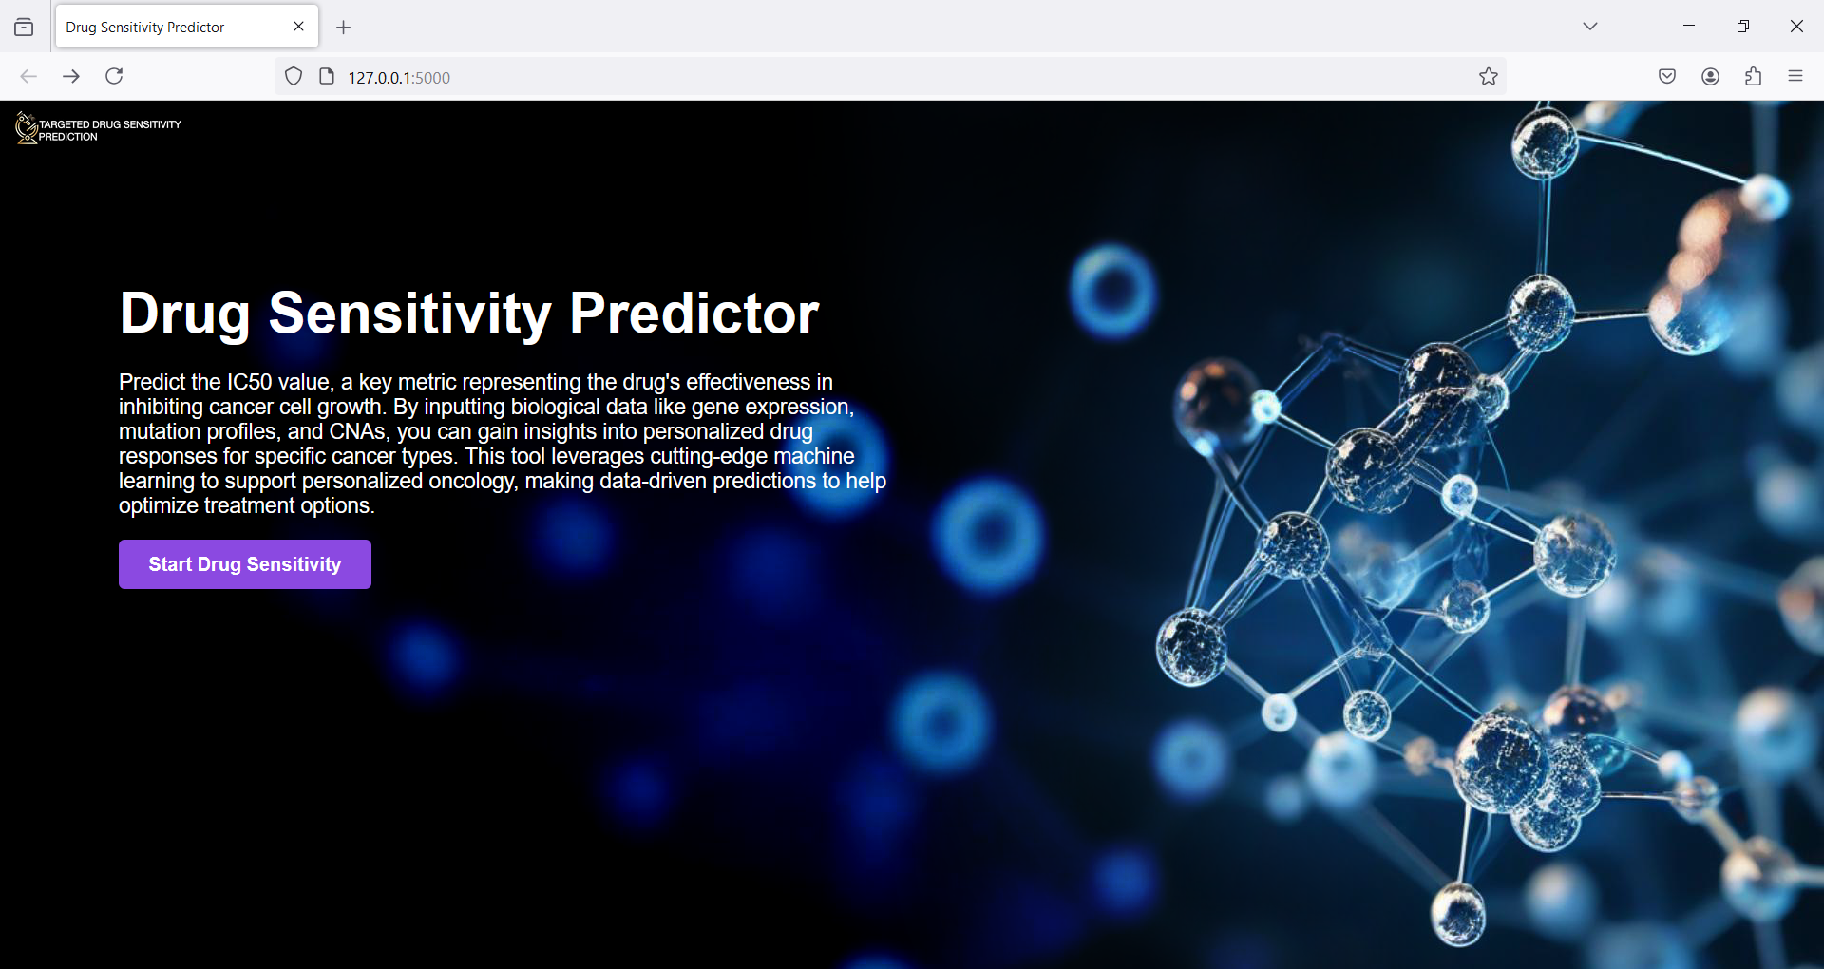
Snapshots

Slide 7
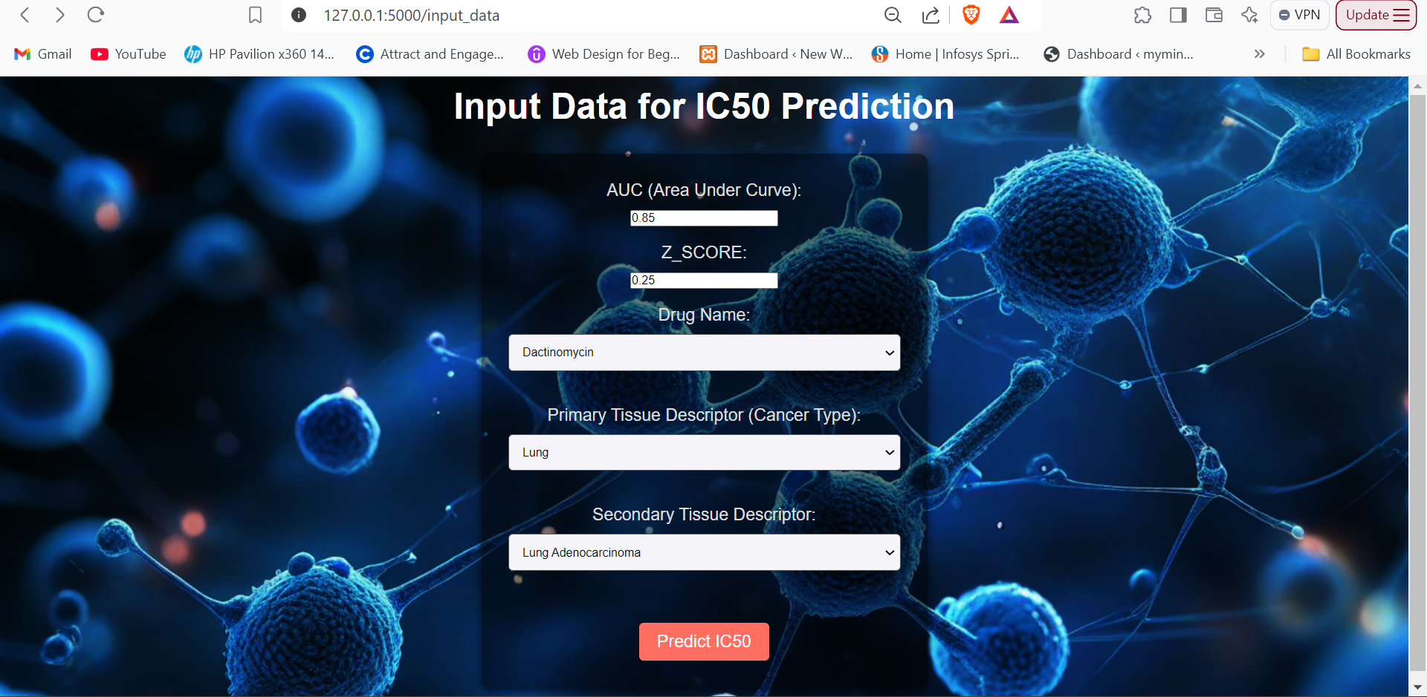

Slide 8
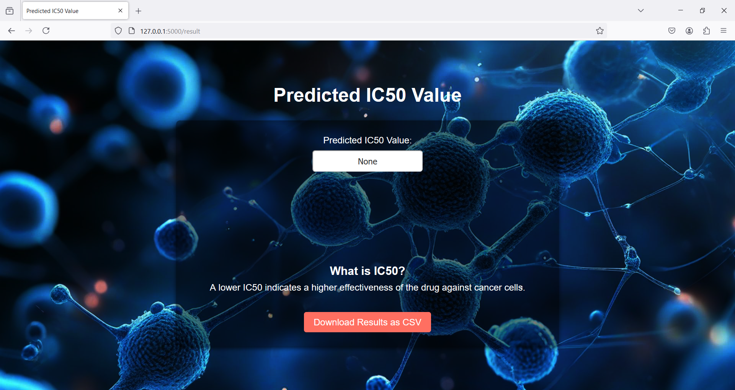

Slide 9
Methodology
Handling Missing Values
Correlation Analysis
Scaling the Numerical Features (Min Max)
Encoding Categorical Features
Feature selection
Test-Train splitting

